Slide 1
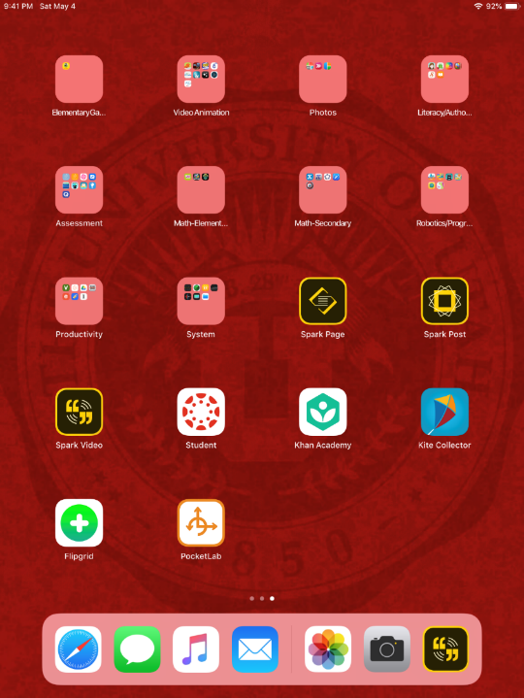
Camera Roll (Storing photos/videos – added automatically)
Camera at a Glance (Recording photos/videos)
Adobe Spark Video (Editing your photos/videos and retelling your story)

Slide 2
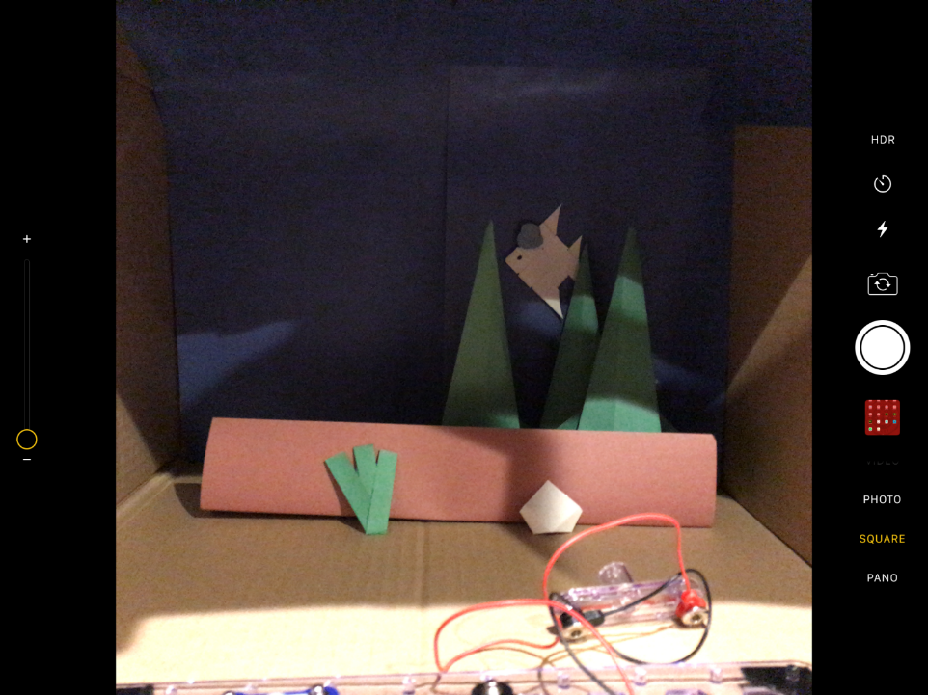
Camera at a Glance
Take a photograph by choosing the dimension (Square) and pressing the Record button.

Slide 3
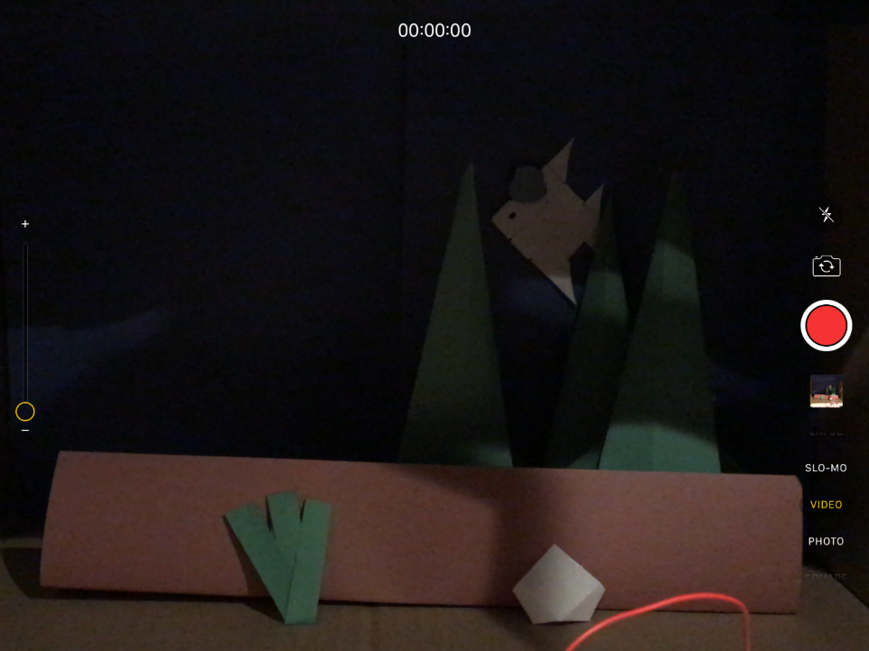
Camera at a Glance
Take a video by choosing the Video option and pressing the red Record button. To stop the recording, press the record button again.

Slide 4
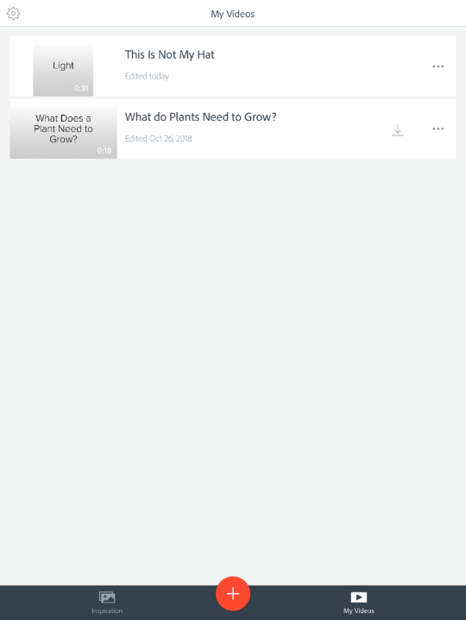
Adobe Spark Video
Open the Adobe Spark Video app. Select the “New Project” button at the bottom.

Slide 5

Write a title for your new project and select “Next”.

Slide 6
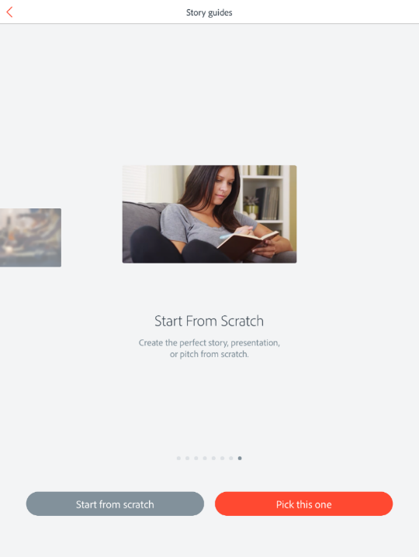
Choose a story guide – I recommend the “Start From Scratch” option. Scroll down and select the option and choose “Pick this One”.

Slide 7
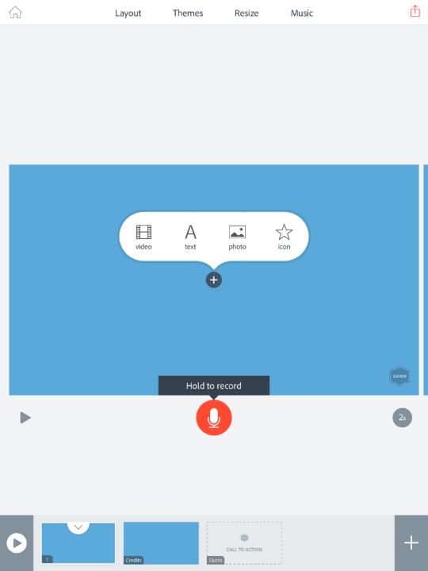
Select any one of these options to format the appearance of your slides.
Add content to any slide by choosing one of these options. Sound can be added by pressing the record button.
Navigate to each slide and preview the video by selecting the “Play” button.

Slide 8
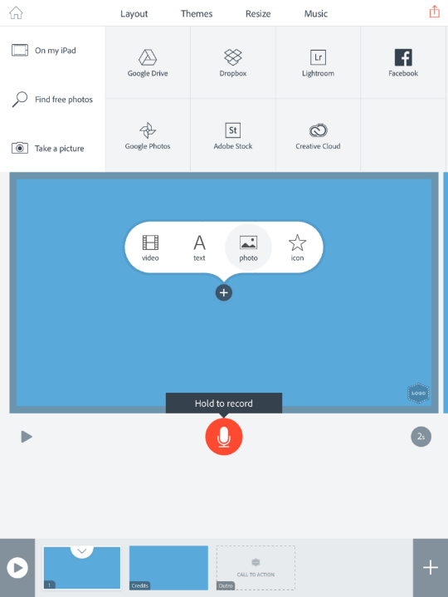
To add your photograph to a slide, select “Photo”.
Choose “On My iPad”.

Slide 9
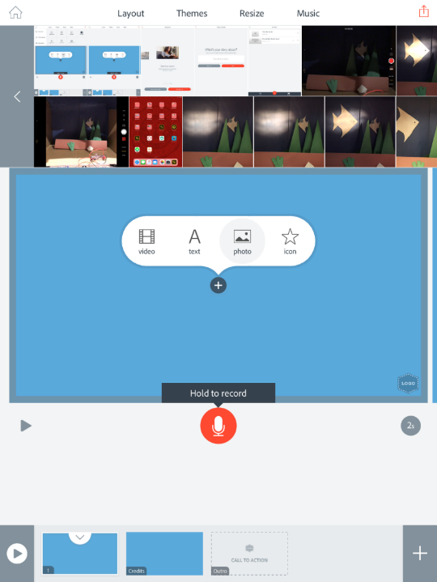
Select your photograph.

Slide 10
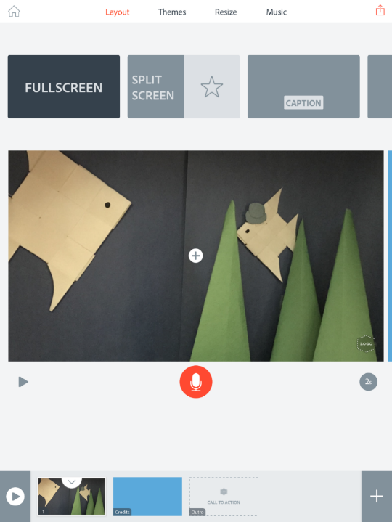
To format the appearance of your slide, select Layout to add multiple photos or textbox captions.
Pinch the photo to resize and move it on the slide.

Slide 11
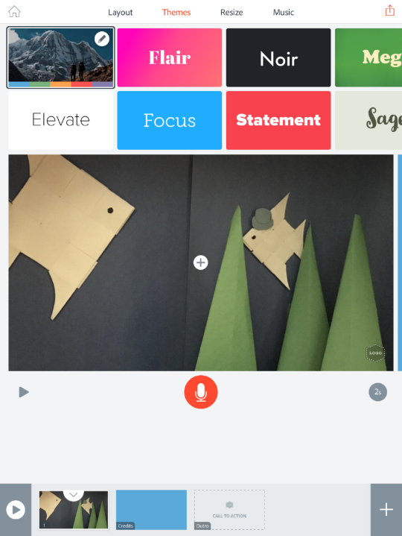
Select a Theme from the list of options to add background color and text fonts.

Slide 12
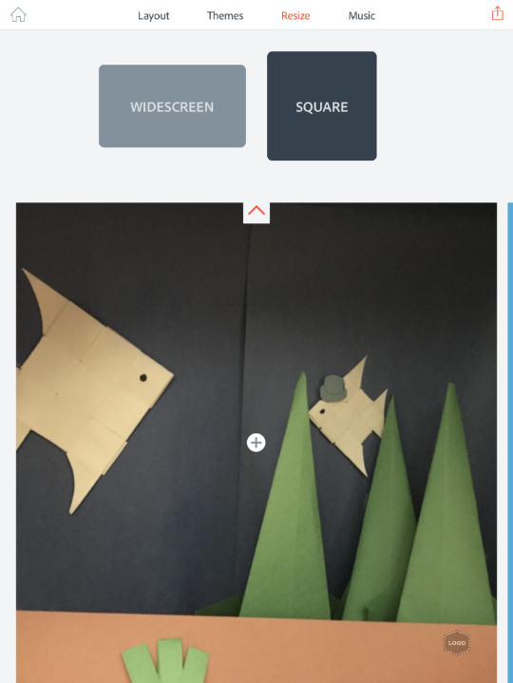
Select Resize to choose between Square or Widescreen dimensions.

Slide 13
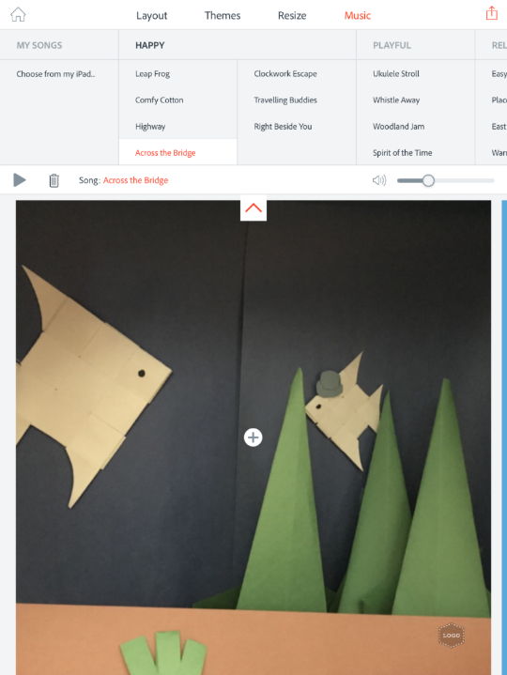
Music can be added to each slide (or the project as a whole). Adjust the sound to preview the results.

Slide 14
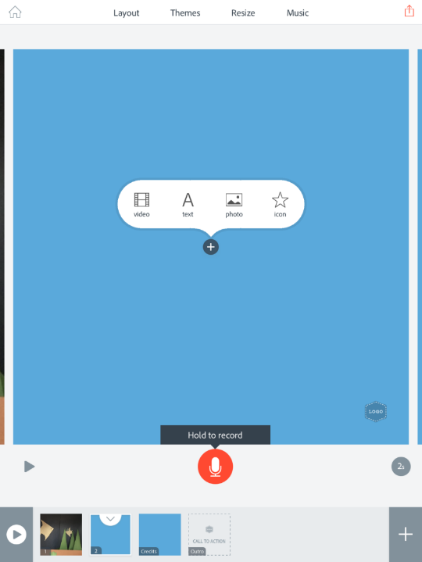
To add a video, select “Video”.

Slide 15
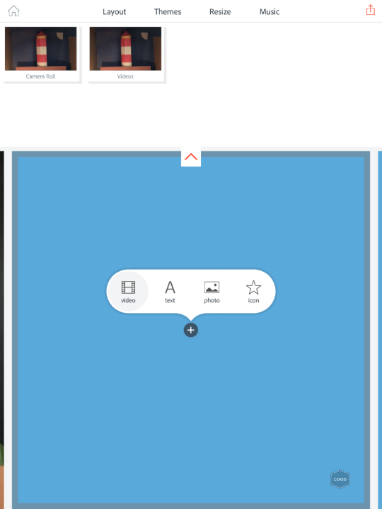
Choose your video saved in the Camera Roll app.

Slide 16
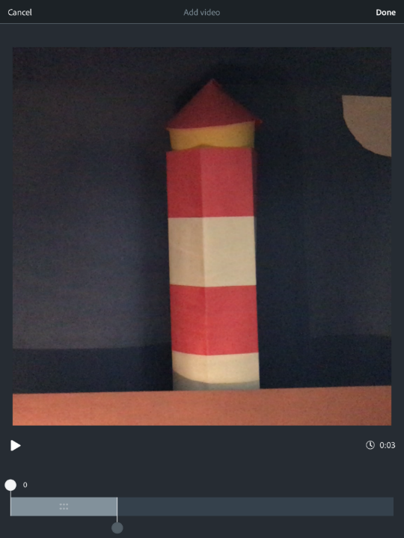
Move the slider bar to highlight the clip of the video that you would like to be featured on the slide.

Slide 17
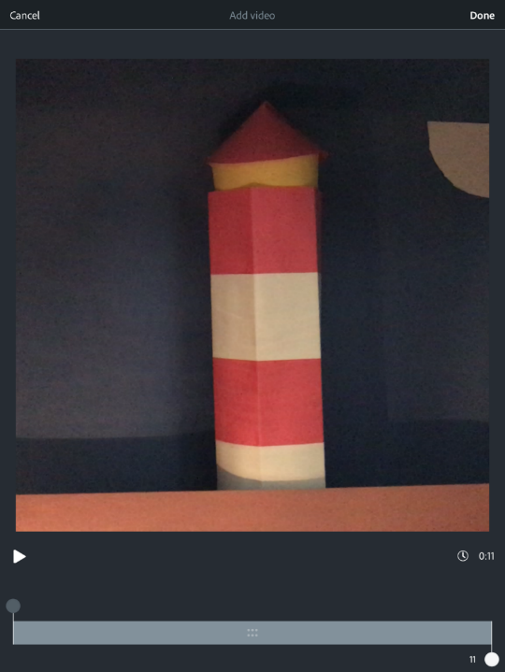
Select “Done”.

Slide 18
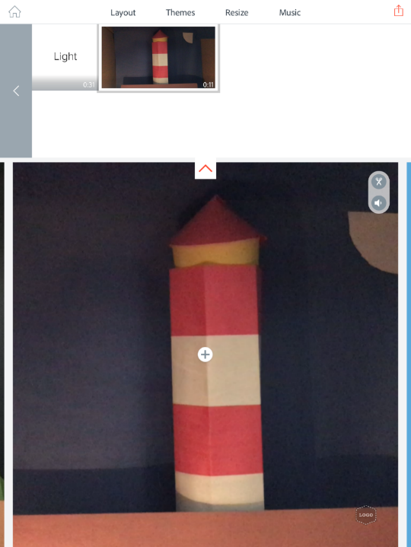
Pinch the video on the slide to resize and move it. You can also edit the sound of the video to mute or play it louder.

Slide 19
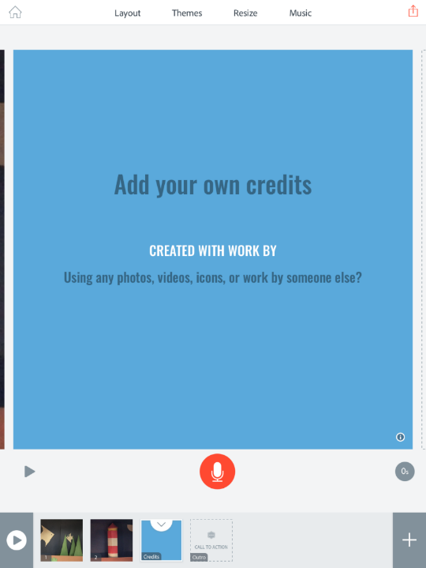
To finish your video, add your names and the title and credit the author of the story “This is Not My Hat by Jon Klassen”.

Slide 20
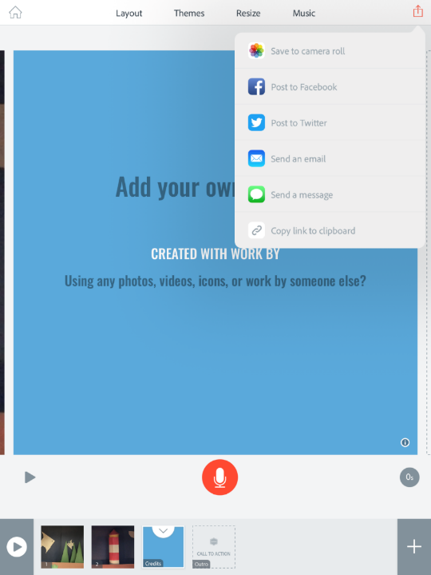
Select the “Share” icon. Then, choose “Save to Camera Roll”.

